Slide 1
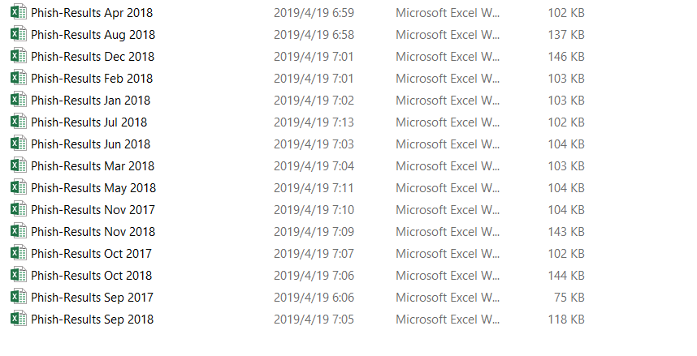
Phish results in UNCC

Slide 2
Data information
Time: 2017.9, 10, 11; 2018.1-12
Department information
Not Clicked/Clicked
No Action/Email Opened
Male/Female
Age Range

Slide 3
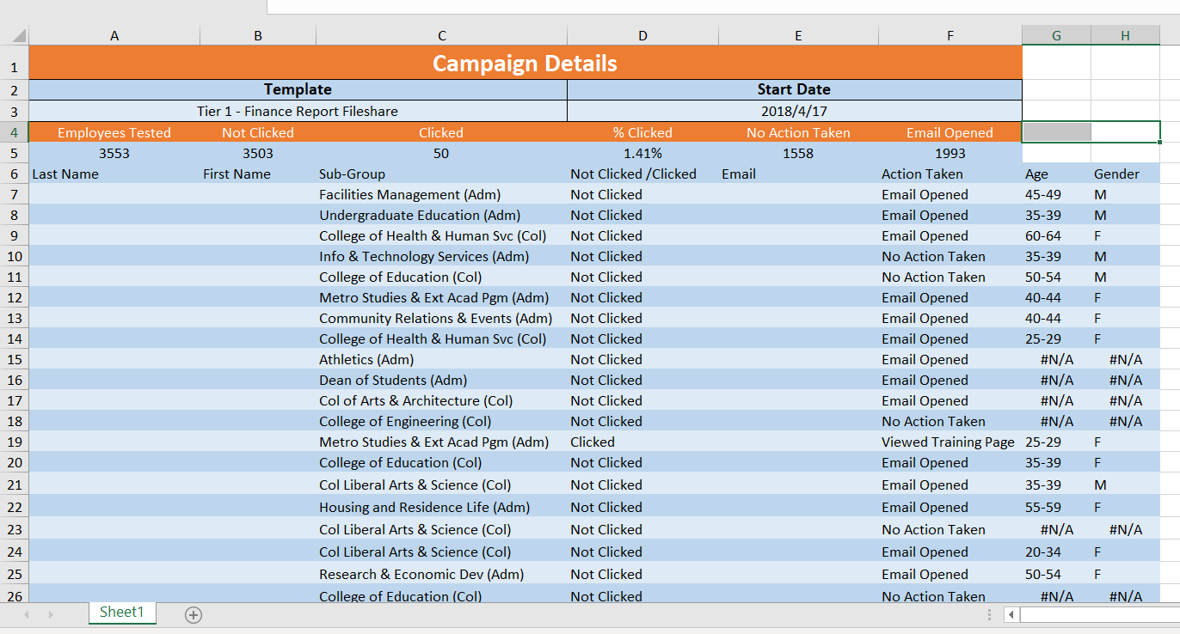
April 2018 data

Slide 4
Topic of phishing emails
2017.9:
Over Quota Second Notice
2017.10:
Invoice Attachment
2017.11:
Failed Delivery
2018.1:
Security Vulnerabilities
2018.2:
Email Verification Required
2018.3:
Tax Return
2018.4:
Finance Report Fileshare
2018.5:
Fax Received

Slide 5

2018.6:
Confirm Payment
2018.7:
System Upgrade
2018.8:
Security Update
2018.9:
New shared file
2018.10:
Purchase order?
2018.11:
Invoice Attached
2018.12:
Action Required

Slide 6
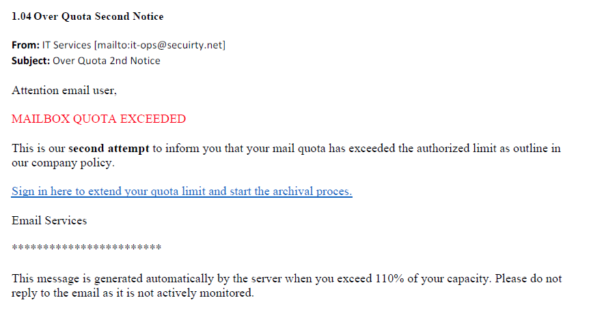
2017.9: Over Quota Second Notice

Slide 7
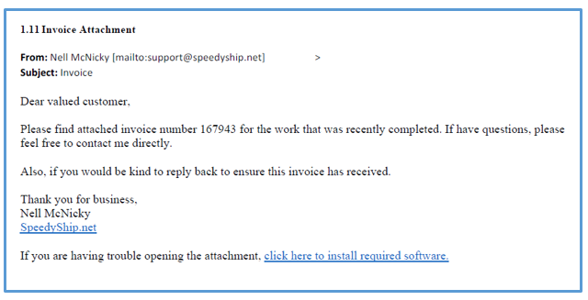
2017.10: Invoice Attachment

Slide 8
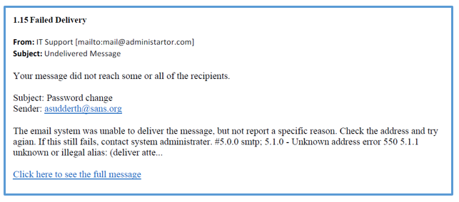
2017.11: Failed Delivery

Slide 9
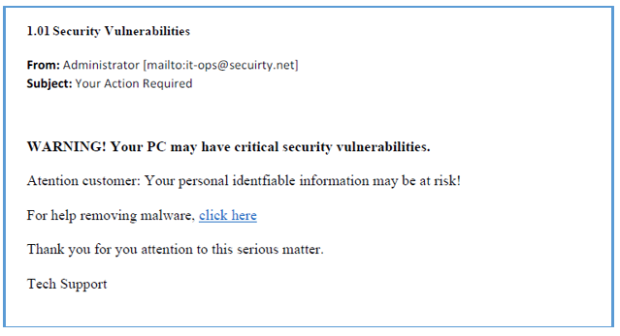
2018.1: Security Vulnerabilities

Slide 10
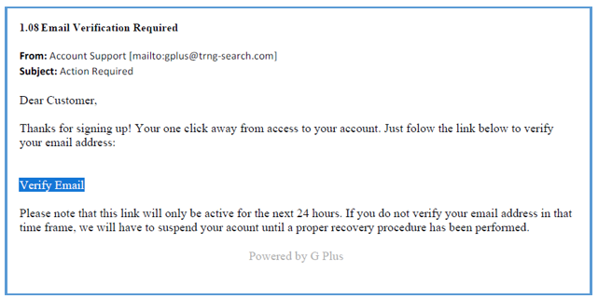
2018.2: Email Verification Required

Slide 11
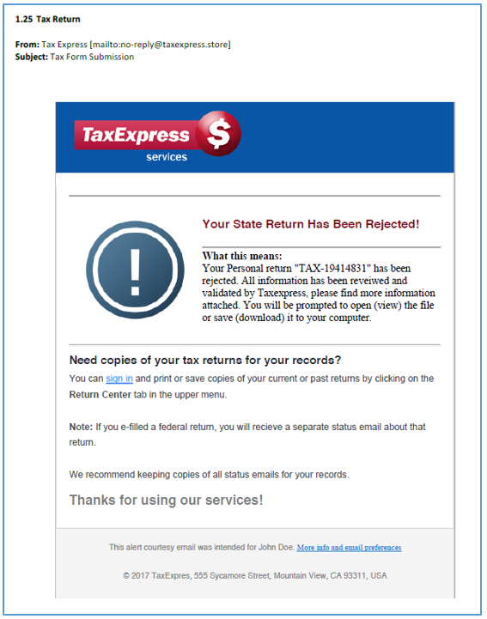
2018.3: Tax Return

Slide 12
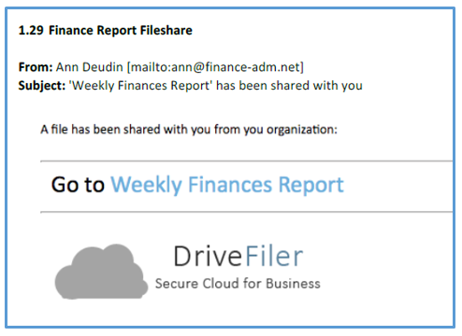
2018.4: Finance Report Fileshare

Slide 13
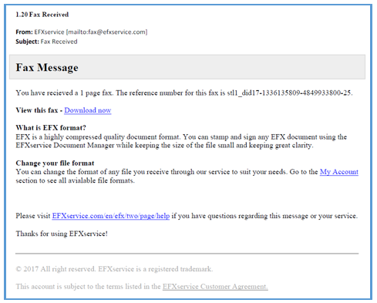
2018.5: Fax Received

Slide 14
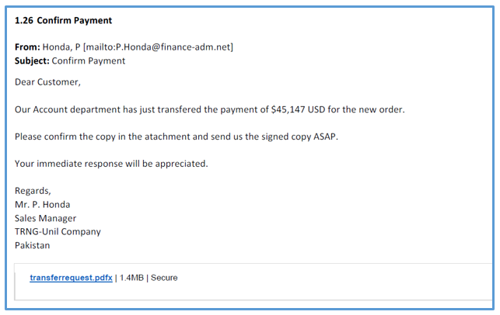
2018.6: Confirm Payment

Slide 15
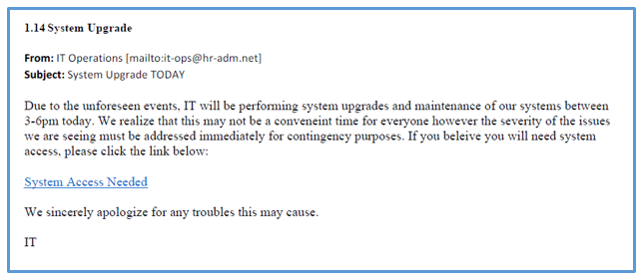
2018.7: System Upgrade

Slide 16
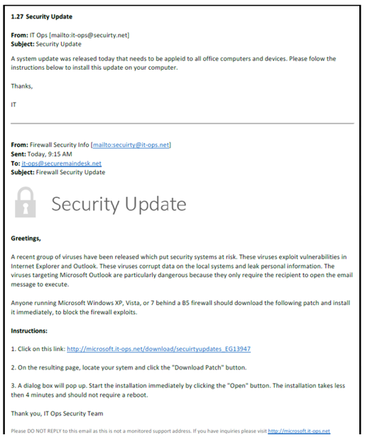
2018.8: Security Update

Slide 17
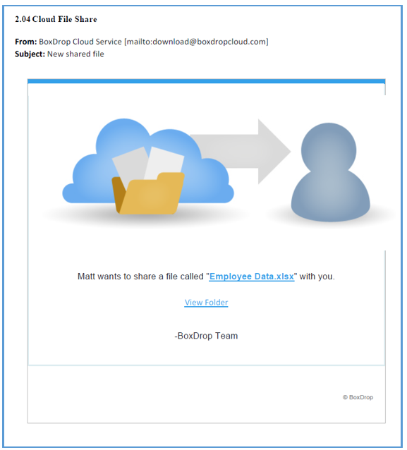
2018.9: New shared file

Slide 18
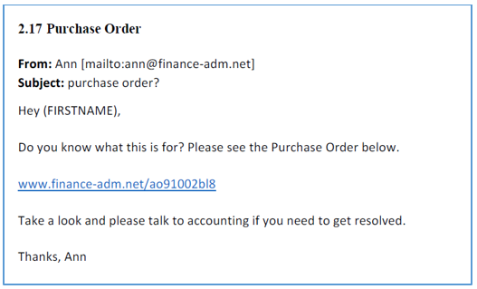
2018.10: Purchase order?

Slide 19
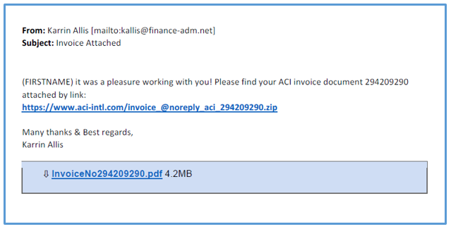
2018.11: Invoice Attached

Slide 20
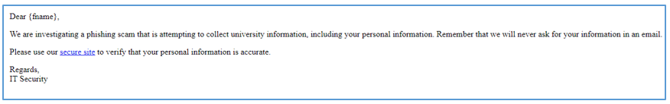
2018.12: Action Required

Slide 21
Date | Employees | Not Clicked | Clicked | % Clicked | No Action | Email Opened
2017.9 | 3516 | 3431 | 85 | 2.42% | 843 | 2670
2017.10 | 3532 | 3354 | 178 | 5.04% | 540 | 2989
2017.11 | 3545 | 3033 | 512 | 14.44% | 710 | 2818
2018.1 | 3540 | 3485 | 55 | 1.55% | 1016 | 2523
2018.2 | 3555 | 3545 | 10 | 0.28% | 2484 | 1071
2018.3 | 3557 | 3450 | 107 | 3.01% | 938 | 2618
2018.4 | 3553 | 3503 | 50 | 1.41% | 1558 | 1993
2018.5 | 3563 | 3229 | 334 | 9.37% | 229 | 3333
2018.6 | 3570 | 3462 | 108 | 3.03% | 950 | 2613
2018.7 | 3504 | 3387 | 117 | 3.34% | 1123 | 2381
2018.8 | 3511 | 3431 | 80 | 2.28% | 1497 | 2014
2018.9 | 3660 | 3184 | 476 | 13.01% | 1039 | 2621
2018.10 | 4618 | 3432 | 1186 | 25.68% | 803 | 3815
2018.11 | 4662 | 4121 | 541 | 11.60% | 1048 | 3614
2018.12 | 4662 | 4515 | 147 | 3.15% | 1210 | 3452

Slide 22
Phishing in an Academic Community: A Study of User Susceptibility and Behavior (2018)
In spring 2018, delivered phishing attacks to 450 randomly selected students in each experiment (1,350 students total).
To examine user click rates and demographics among UMBC’s undergraduates.
Experiment 1: PayPal (Billing Problem)
Experiment 2: Quadmania (Contest Winner)
Experiment 3: DoIT (Expiration Date phishing)

Slide 23
Demographics were examined
Age
Gender
College affiliation (Administration/College)
Academic year progression
Time spent on a computer
Cyber club/cyber scholarship program affiliation
Cyber training
Phishing awareness

Slide 24
Major findings
STEM majors–with Engineering and IT majors in particular–had lower click rates (EIT 65%, NMS 70%) compared to non-STEM majors (AHSS 80%).
No significant correlation between gender and susceptibility.
Correlations resulting in lowered susceptibility based on age demographics.

